Slide 1
Geographical Variation in robotic surgical procedures in the Midlands
Presented by:
Rebecca Elleray
Submitted for publication and under review
Notes:
Standard title slide

Slide 2
Introduction
The questions this analysis has answered:
What is the geographical variation in the use of robotic surgery for colectomy, hysterectomy, cystectomy, nephrectomy and prostatectomy for relevant cancer diagnoses by ICB of residence?
Which trusts are carrying out the most robotic surgeries for these procedures and indications?
Is this variation related to need as measured by cancer incidence for the relevant indications?
Are there any differences between systems in coding or use of these robotic procedures for other diagnoses that may lead to difficulties in understanding how use relates to need in a population?
What is the breakdown of nephrectomy robotic surgeries by radical and partial procedures
Submitted for publication and under review

Slide 3
Headlines
Residents of Coventry and Warwickshire ICB received the highest rates of robotic surgery in the region between April 2019 and March 2023 for urological and uterine cancers and the second highest for colonic resections for colorectal cancer. The rates were significantly higher than the national average. This appears largely unrelated to need as the incidence of all of these cancers was similar to the England average between 2018-2020
Several of our ICBs have significantly higher than average rates of cancer. However, these ICBs often had significantly lower rates of robotic surgery than the national average but, higher rates of non-robotic surgery
Residents of Staffordshire & Stoke-on-Trent ICB had a significantly higher rate of robotic colonic resection surgery for colorectal cancer compared to the national average
Residents of Leicester, Leicestershire & Rutland and Nottingham & Nottinghamshire ICBs had significantly higher rates of robotic surgery for uterine cancer than the national average and also had high rates of uterine cancer incidence in the population – LLR was significantly higher than the national average. Rates of robotic surgery for uterine cancer may therefore reflect need in these populations
For urological cancer, the greatest proportion of robotic surgeries carried out among patients living in the Midlands, occurred at providers situated outside of the region ((22.1% n= 2,461). Almost half of these are residents of Derby & Derbyshire and Herefordshire &Worcestershire ICBs
Among trusts in the Midlands, University Hospitals Coventry and Warwickshire NHS Trust had the greatest proportion of robotic surgery for uterine cancer (25.3%) and urological cancer (16.3% n= 1,816) and second highest for colonic resection for colorectal cancer (21.0% n= 232). University Hospitals of North Midlands NHS Trust carried out the highest proportion of robotic surgery for colorectal cancer (29.6% n= 325)
There may be some differences between systems in the coding of diagnoses for urological indications that may make it difficult to understand the relationship between need and use of robotic surgery
There appears to be some differences across systems in the use of robotically assisted hysterectomy and colectomy for other non-cancer conditions of the uterus and intestinal organs
Submitted for publication and under review

Slide 4
Methodology
Data for the financial years April 2019 to March 2023 were extracted from the admitted patients secondary uses service (SUS) dataset for all England resident patients
Surgery codes for colectomy, hysterectomy, cystectomy, nephrectomy and prostatectomy were collated using the National Clinical Improvement Programme methodology (see slide 5 for details)
Robotic procedures were further defined using the OPCS codes that indicated the procedure was carried out robotically (see slide 5 for details)
Procedures were further filtered based on the ICD10 code of diagnosis to extract only those that were carried out for cancer - Uterine (ICD C54-C55), Colorectal (ICD C18-C20) and prostate (ICD 61), Kidney (ICD C64) and Bladder (ICD C67)
Age at time of procedure was used to group patients into 5-year age bands
Patients were assigned to an ICB based on the lower super output area of residence at the time of the procedure
Patients were assigned to a trust based on the provider code of trust associated with the procedure record
Age-standardised rates per 100,000 were calculated using the direct method, using mid-2020 population estimates and Dobson method for calculating confidence intervals set at the 95% confidence level
The age standardised rates and associated confidence intervals at ICB level were compared to the national average age standardised estimate. The ICB rate was considered statistically significantly different to the national average based on non-overlapping confidence intervals with the national average. Where confidence intervals overlapped with the national average, rates are not considered statistically significantly different
Data for the age standardised rate of cancer incidence in 2018-2020 was extracted from the CancerData portal CancerData – this data uses cancer registration data collated from the National Disease Registration Service (NDRS)
Submitted for publication and under review

Slide 5
Methodology – OPCS codes to define procedures
Prostatectomy - M611,M612,M613,M614,M618,M619
Cystectomy - M341,M342,M343,M344,M348,M349,X142
Nephrectomy - M021,M025,M028,M029
Partial Nephrectomy - M031,M032, M038,M039)
Hysterectomy - Q071,Q072,Q073,Q074,Q075,Q076,Q078,Q079, Q081,Q082,Q083,Q088,Q089
Colectomy - H041 H048, H049, H042, H043, H051, H112, H114, G725, H661, H662, H668, H669, H053, H052, H058, H059, H061, H062, H063, H064, H065, H068, H069, H071, H072, H074, H075, H078, H079, H333, H334, H336, H331, H335, H08, H082, H083, H084, H085, H086, H088, H089, H101, H102, H103, H104, H105, H106, H108, H109, H091, H092, H093, H094, H095, H096, H098, H099, H111, H111, H113, H115, H116, H118, H119, H291, H292, H293, H294, H295, H298, H299, H501, H502, H503, H508, H509
Procedures performed robotically were defined using - Y753, Y452, Y765, Y743
Submitted for publication and under review

Slide 6
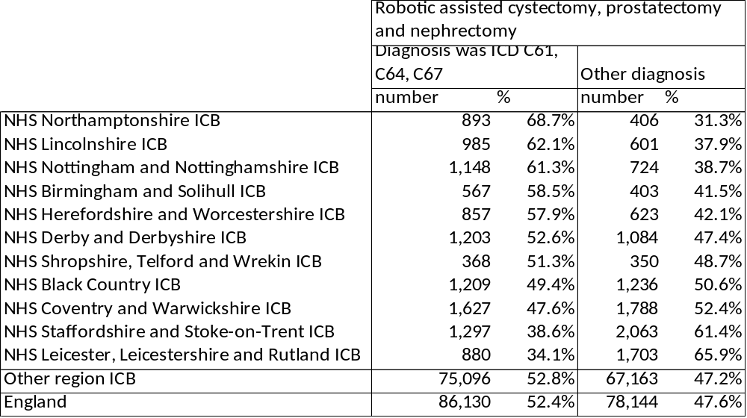
Overview of robotic procedures for defined indications – cystectomy, prostatectomy, nephrectomy
This analysis counts all procedures coded as a robotically assisted cystectomy, prostatectomy and nephrectomy and splits them into those that had a diagnosis of C61, C64 and C67 and those with any other diagnosis recorded in the primary diagnosis field. It highlights that for this indication, there may be some differences in how diagnoses are recorded.
For example, a closer inspection of data for LLR found that 250 procedures had an ICD code in the primary diagnosis field indicating ICD N40 - Benign prostatic hyperplasia and ICD Z29 encounter for other prophylactic measures. Other systems have not used these codes in the primary diagnosis field
Other differences arise from the use of these procedures for other diagnoses.
Other cancer diagnoses than prostate, kidney and bladder cancers make up a large proportion of these robotic procedures.
These differences in coding can make it difficult to compare to need.
Submitted for publication and under review

Slide 7
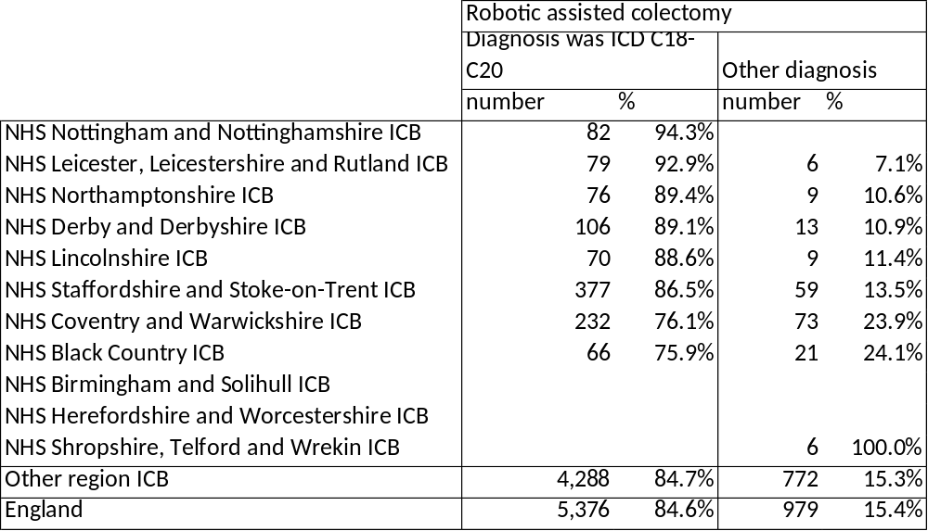
Overview of robotic procedures for defined indications – colectomy
This analysis counts all procedures coded as a robotically assisted colectomy and splits them into those that had a diagnosis of C18-C20 and those with any other diagnosis recorded in the primary diagnosis field. It highlights that for this indication that there may be some differences in how this procedure is being used.
For example, a closer inspection of data for Staffordshire and Stoke-on-Trent and Coventry and Warwickshire shows that robotic procedures used for non-cancers had a primary diagnosis of other intestinal conditions such as diverticulitis
Submitted for publication and under review

Slide 8
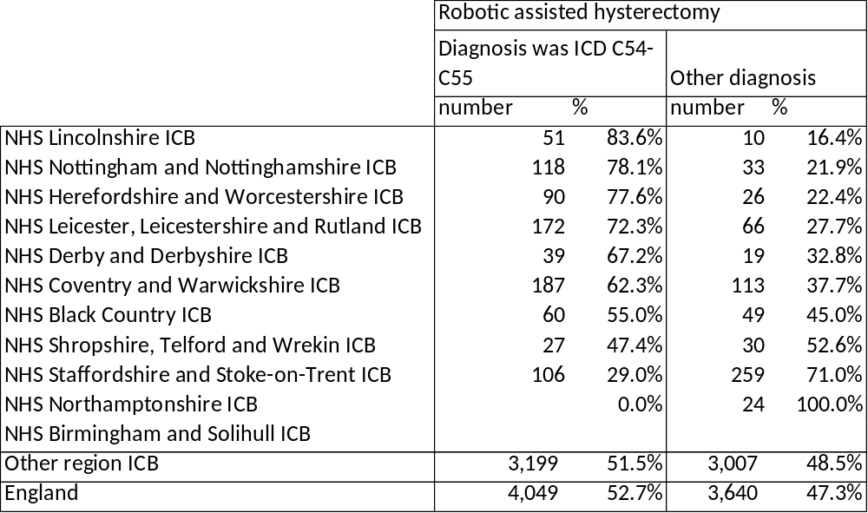
Overview of robotic procedures for defined indications – hysterectomy
This analysis counts all procedures coded as a robotically assisted hysterectomy and splits them into those that had a diagnosis of C54-C55 and those with any other diagnosis recorded in the primary diagnosis field. It highlights that for this indication that there may be some differences in how this procedure is being used.
For example, a closer inspection of data for Staffordshire and Stoke-on-Trent shows that over 100 robotic procedures had a primary diagnosis of endometriosis or other gynaecological condition
Other differences arise from the use of these procedures for other cancer diagnoses of surrounding organs and for benign types such as Leiomyoma
Submitted for publication and under review

Slide 9
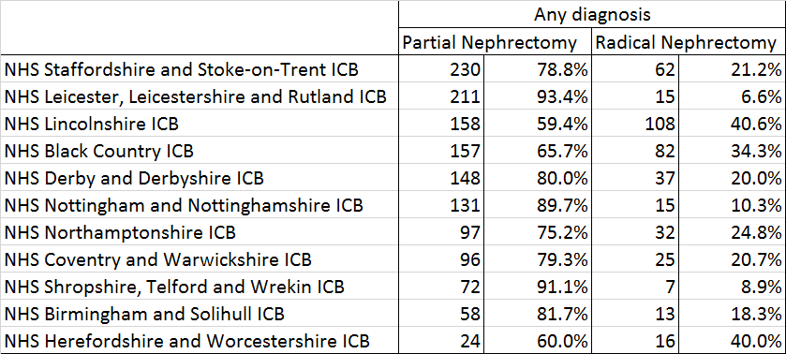
Overview of robotic procedures for radical and total nephrectomy separately
This table splits out the robotic procedures for partial and radical nephrectomy. Data could not be split by primary diagnosis of urological cancer and primary diagnosis of other condition as this leads to small numbers. This is because for most systems, over 70% of radical or total nephrectomies were carried out for a primary diagnosis of urological cancer.
The exception was for Coventry and Warwickshire, where just under 60% of both procedures were for primary urological cancer diagnoses.
The majority of robotic nephrectomies were for partial procedures. However, Lincolnshire has the greatest number of robotic radical nephrectomy at 40.6% accounting for 108 procedures
Submitted for publication and under review

Slide 10

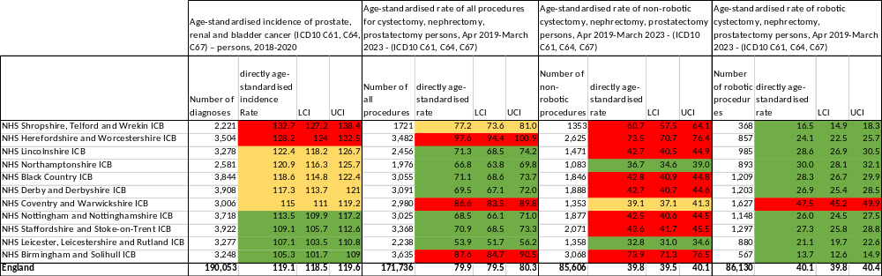
Urological cancer tables
Submitted for publication and under review
(rates shown are per 100,000 people)

Slide 11
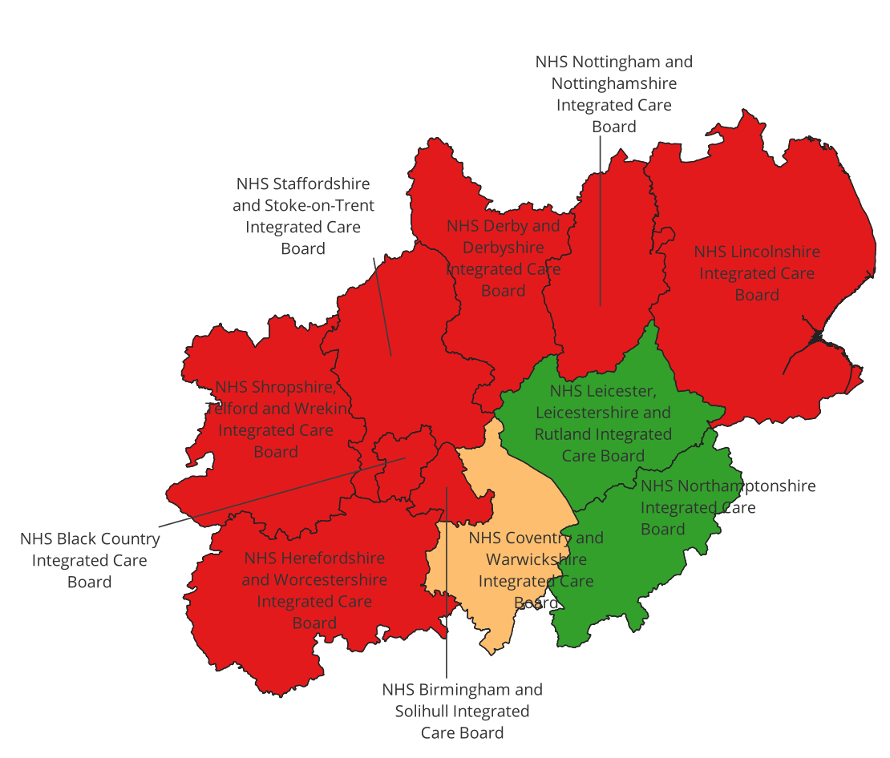
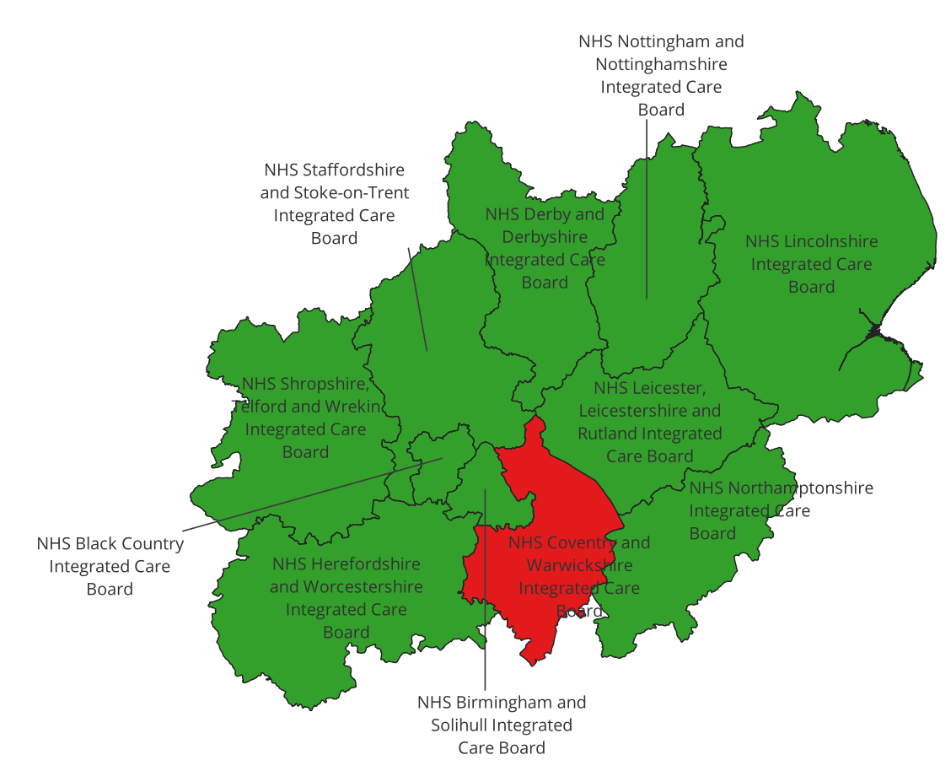
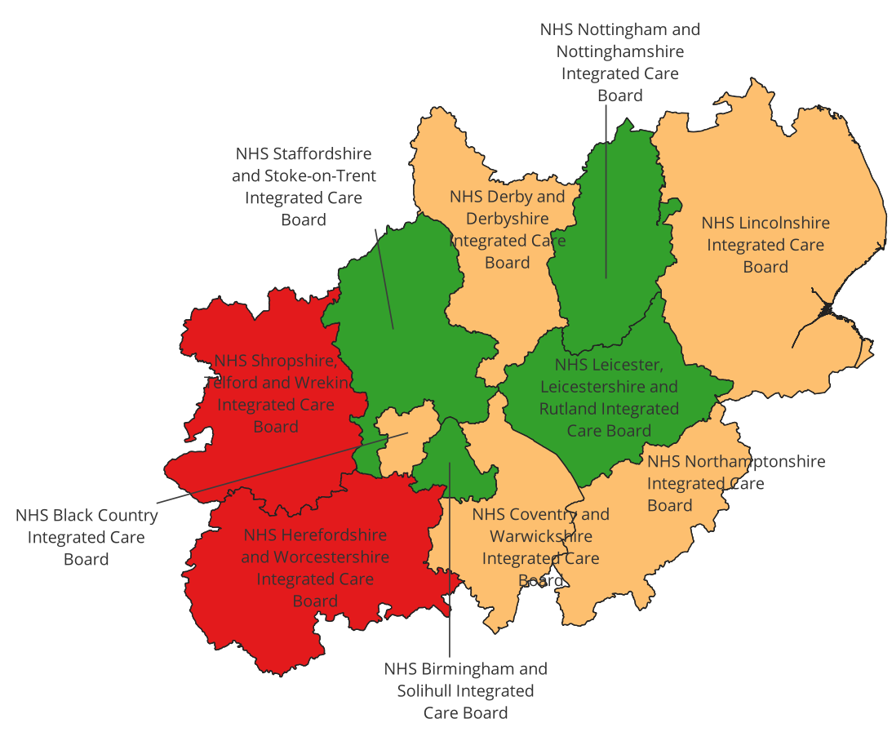
Urological cancer maps
Age-standardised rate of non-robotic cystectomy, nephrectomy, prostatectomy (ICD10 C61, C64, C67) persons, Apr 2019-March 2023
Age-standardised rate of robotic cystectomy, nephrectomy, prostatectomy (ICD10 C61, C64, C67) persons, Apr 2019-March 2023
Age-standardised incidence of prostate and bladder cancer (ICD10 C61, C64 , C67) – persons, 2018-2020
Submitted for publication and under review
(rates shown are per 100,000 people)

Slide 12
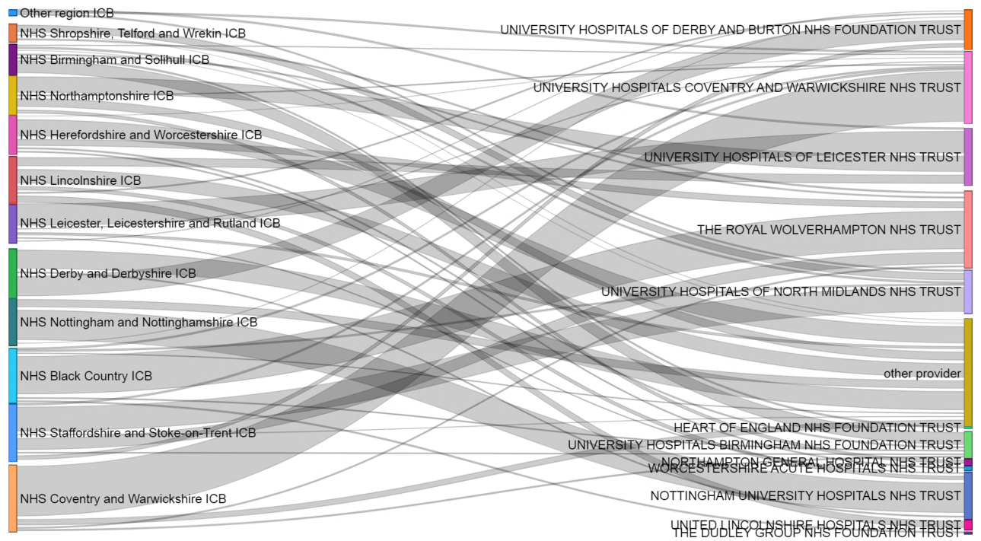
Robotic cystectomy, nephrectomy, prostatectomy patient flows from ICB of residence to trust of procedure
Providers outside of the Midlands region accounted for the largest proportion (22.1% n= 2,461) of robotic surgeries among residents of the Midlands. Almost half of these are residents of Derby & Derbyshire and Herefordshire &Worcestershire ICBs
University Coventry and Warwickshire NHS Trust (16.3% n= 1,816) and The Royal Wolverhampton (14.2% n=1,582) performed the next largest proportion of robotic surgeries
Residents mainly go to their local trust for robotic surgery
Submitted for publication and under review

Slide 13
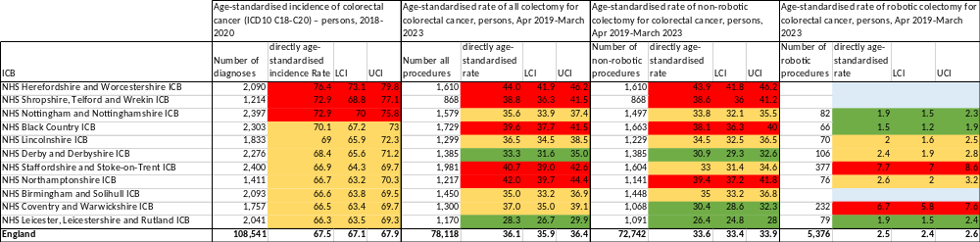
Colorectal cancer tables
Submitted for publication and under review
(rates shown are per 100,000 people)

Slide 14
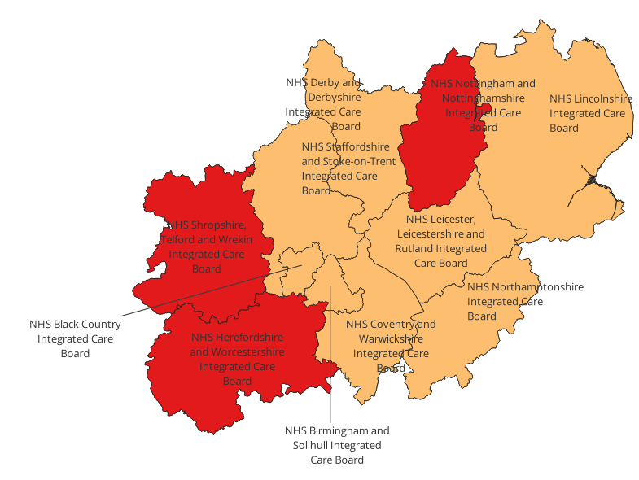
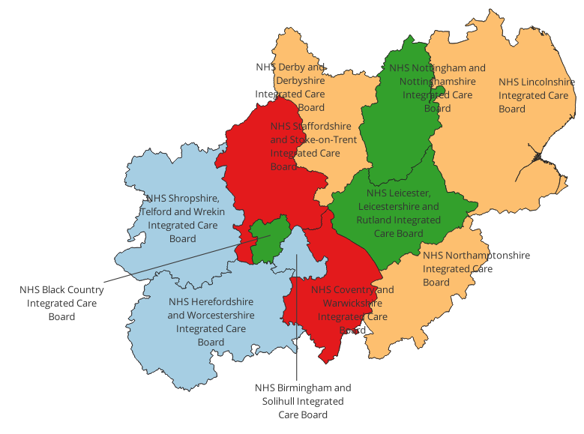
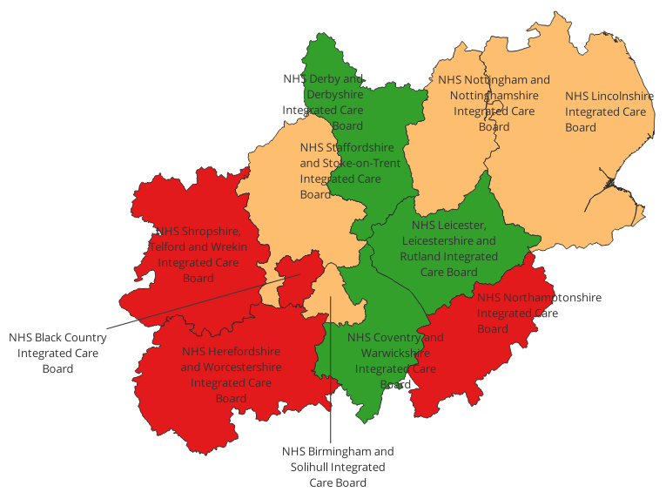
Colorectal cancer maps
Age-standardised incidence of colorectal cancer (ICD10 C18-C20) – persons, 2018-2020
Age-standardised rate of non-robotic colectomy for colorectal cancer, persons, Apr 2019-March 2023
Age-standardised rate of robotic colectomy for colorectal cancer, persons, Apr 2019-March 2023
Submitted for publication and under review
(rates shown are per 100,000 people)

Slide 15
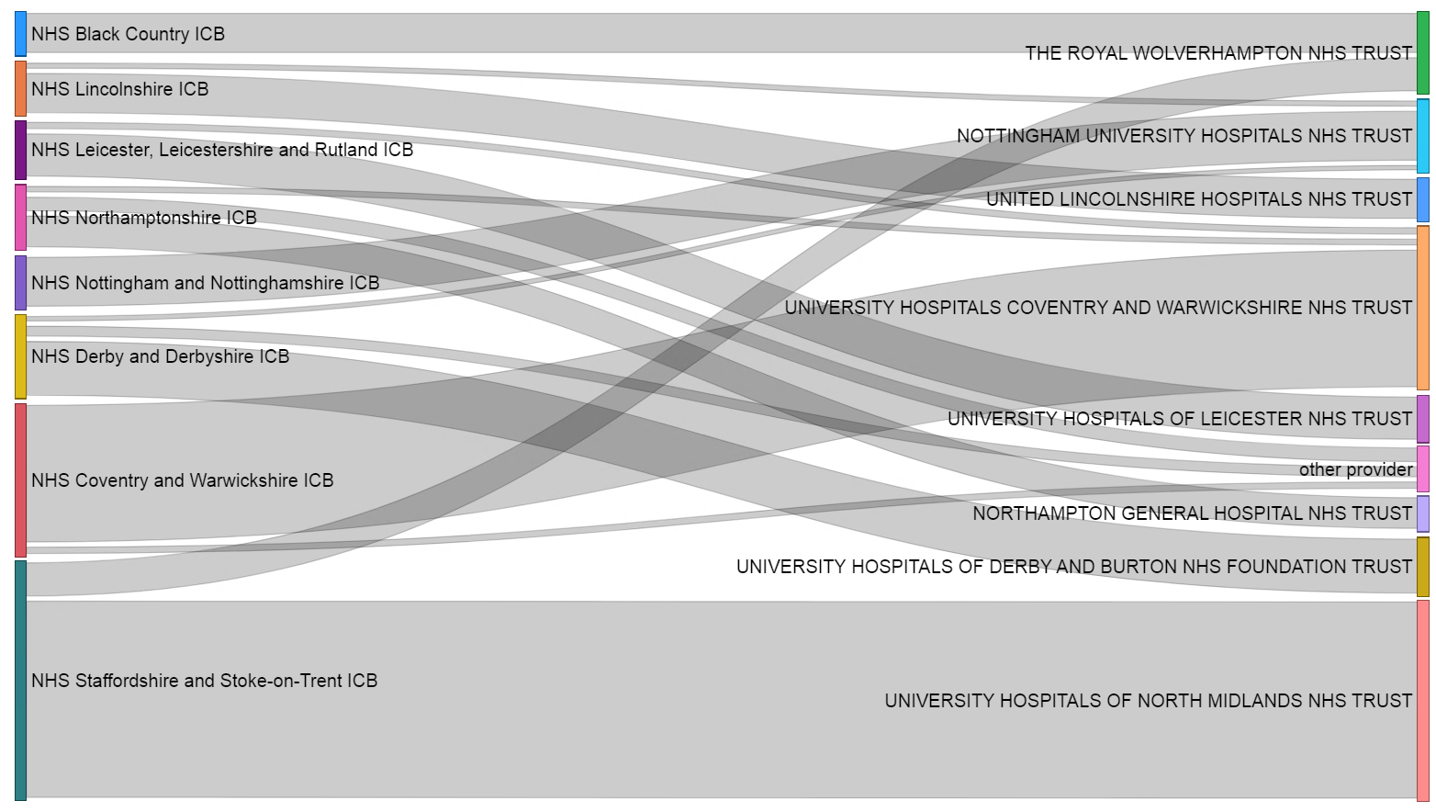
Robotic colectomy patient flows from ICB of residence to trust of procedure
Residents of the Midlands mostly receive robotic surgery in a trust that is also within the region
University Hospitals of North Midlands NHS Trust (29.6% n= 325) and University Coventry and Warwickshire NHS Trust (22.0% n= 242) performed the largest proportion of robotic surgeries
Residents mainly go to their local trust for robotic surgery
Submitted for publication and under review

Slide 16
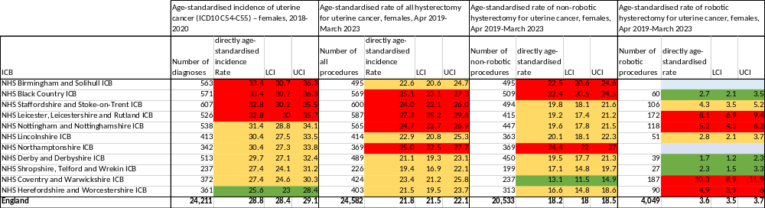
Uterine cancer tables
Submitted for publication and under review
(rates shown are per 100,000 people)

Slide 17
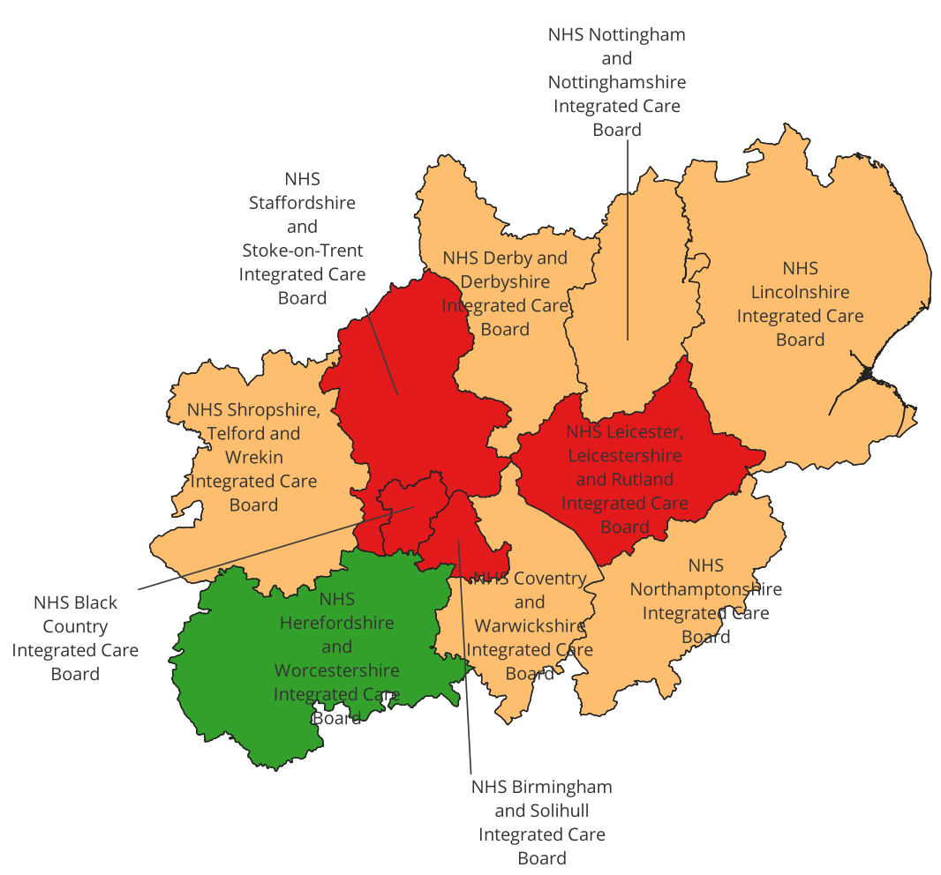
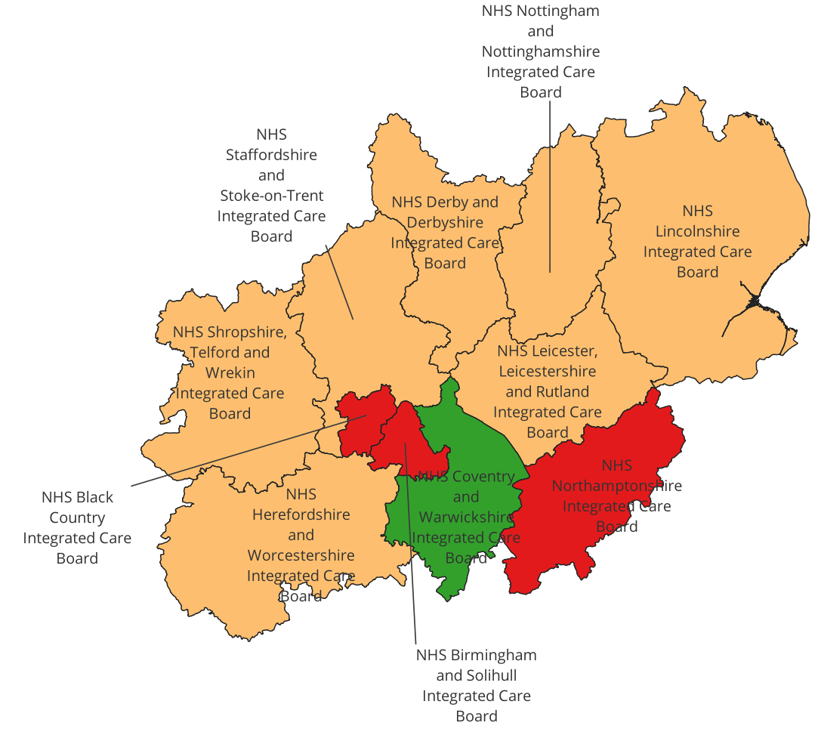
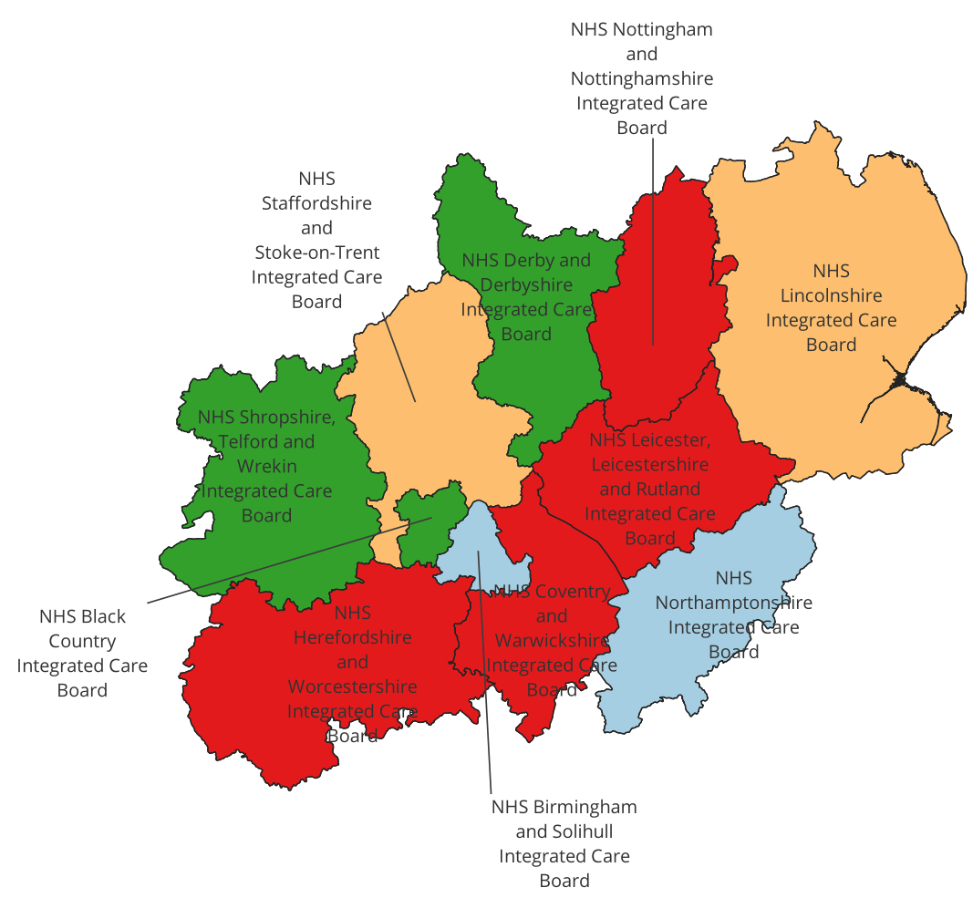
Uterine cancer maps
Age-standardised rate of non-robotic hysterectomy for uterine cancer, females, Apr 2019-March 2023
Age-standardised rate of robotic hysterectomy for uterine cancer, females, Apr 2019-March 2023
Age-standardised incidence of uterine cancer (ICD10 C54-C55) – females, 2018-2020
Submitted for publication and under review
(rates shown are per 100,000 people)

Slide 18
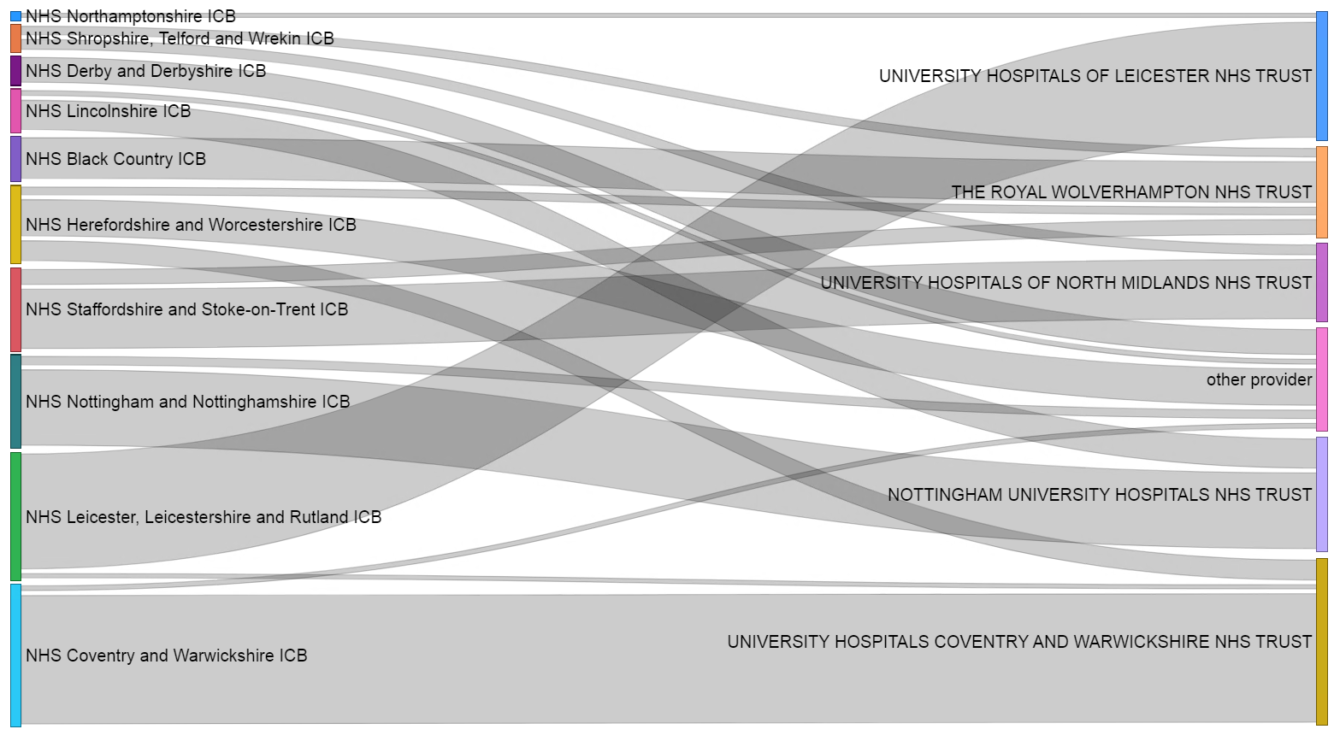
Robotic hysterectomy patient flows from ICB of residence to trust of procedure
Residents of the Midlands mostly go to a trust that is also within the region for robotic surgery, although 13.7% are carried out by trusts in other regions – residents from Derby and Derbyshire and Herefordshire and Worcestershire make up the greatest proportion of this group
University Hospitals Coventry and Warwickshire NHS Trust (25.3%) and University Hospitals of Leicester(19.8%) performed the largest proportion of robotic surgeries
Residents mainly go to their local trust for robotic surgery
Submitted for publication and under review

